Slide 1
Home Automation System
Aagam Shah
Pranav Shankar
Karan Shah

Slide 2
Description
Solution to map the switchboard on a device which can then be used to control their state using website/app.
The main motivation behind the idea is to use the existing electrical setting and offer a device that can help you map and control any connection in your house.
Notes:
a solution which can be used to map the switchboard on our device which can then be used to control their state (on/off).

Slide 3
Proposed Architecture
Client will be the raspberry pi and switchboard
Server will be IBM Bluemix or separate Node JS server
User Interface - website (HTML, CSS) or phone application (Bluemix / Supersonic Appgyver)

Slide 4
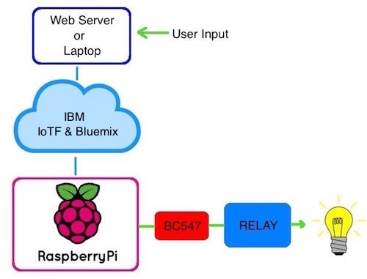
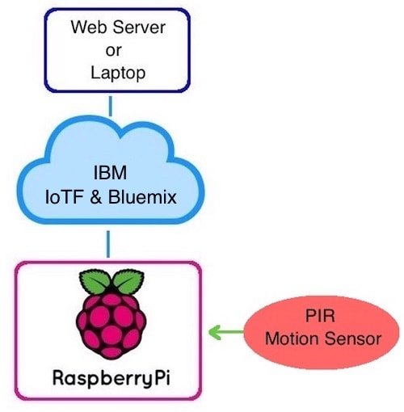
Proposed System Architecture
Sending Data
Receiving Data

Slide 5
Applications
We know what lines are mapped to what appliance which gives us control over :
Individual access to each power socket (application) allowing fine control
Triggering action like power cut off in emergency situation like fire raised by smoke sensor alert raised through our app / SMS / website.
Automatic call to 911 in case of intrusion detected by any motion sensor

Slide 6


